Slide 1
Portfolio
Chow Wai Sing (周瑋陞)

Slide 2
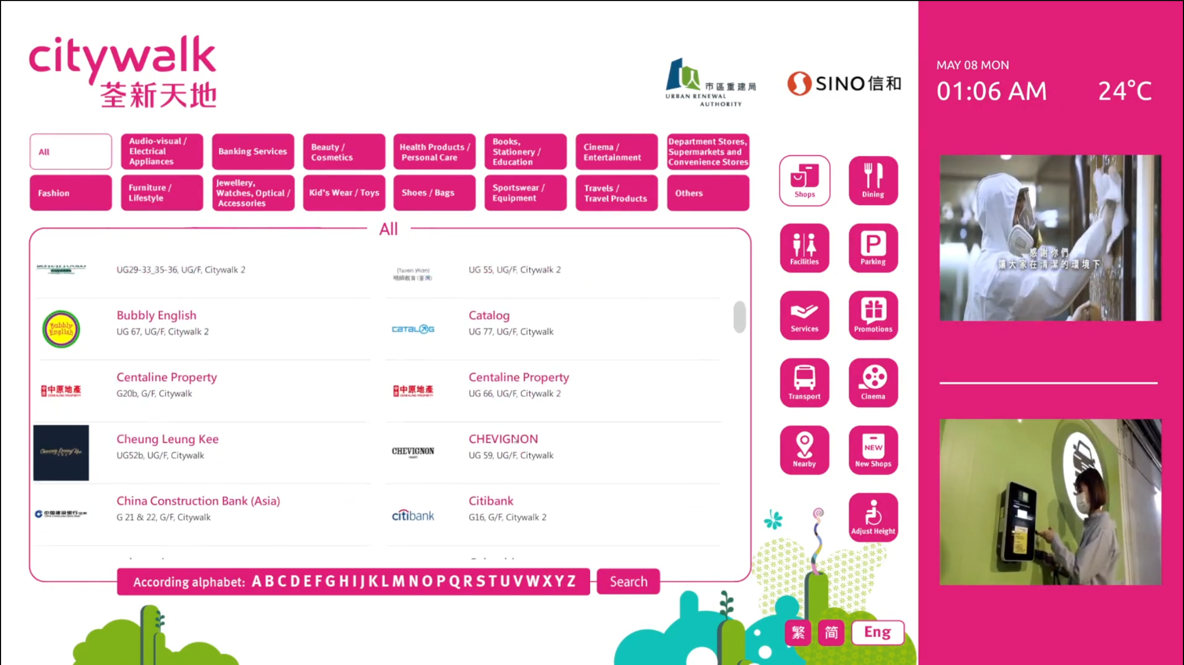
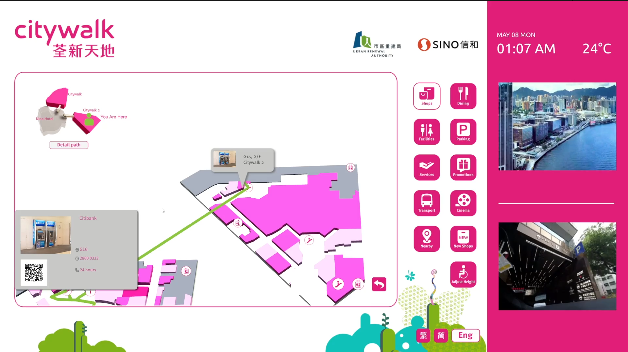
E-Directory (PC, Unity) Video Template
Provide store search and route search
Some shop’s data is stored on server, MYSQL, and download via PHP

Slide 3
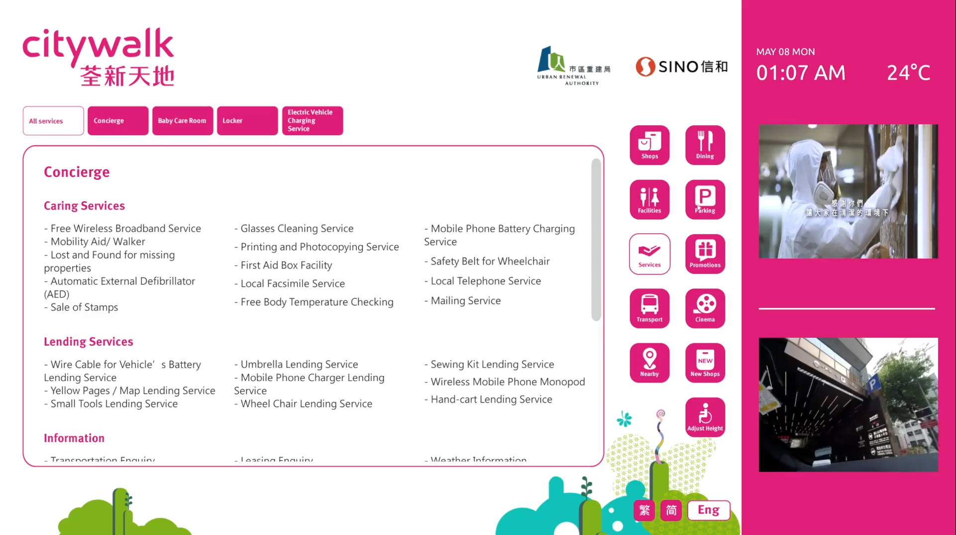
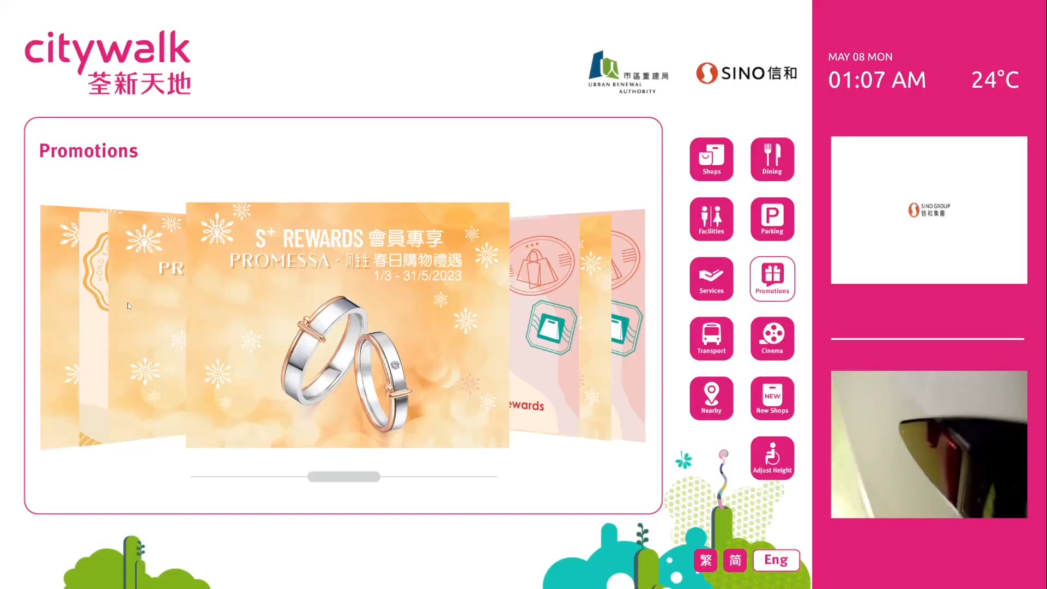
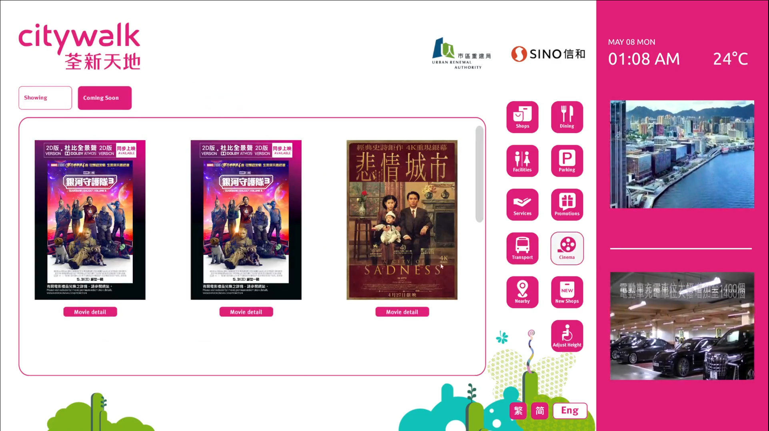
Dynamic scale text field
Scrollable 3D slideshow
Get movie data via Emperor Cinemas API

Slide 4
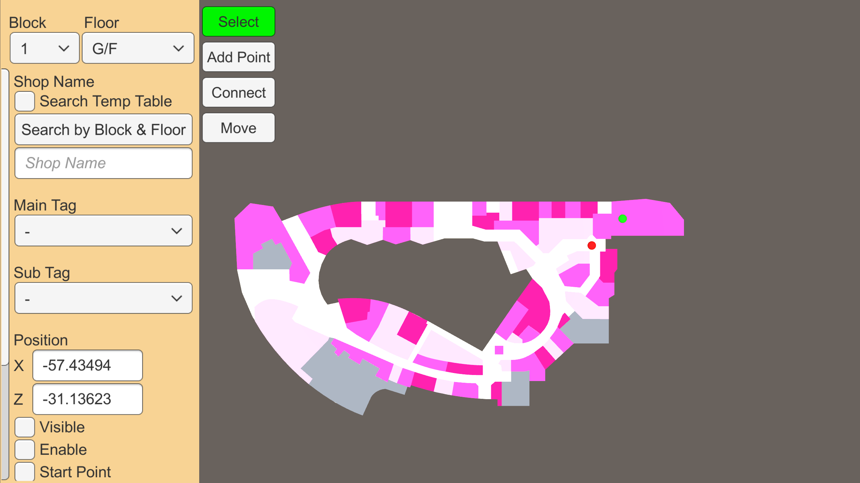
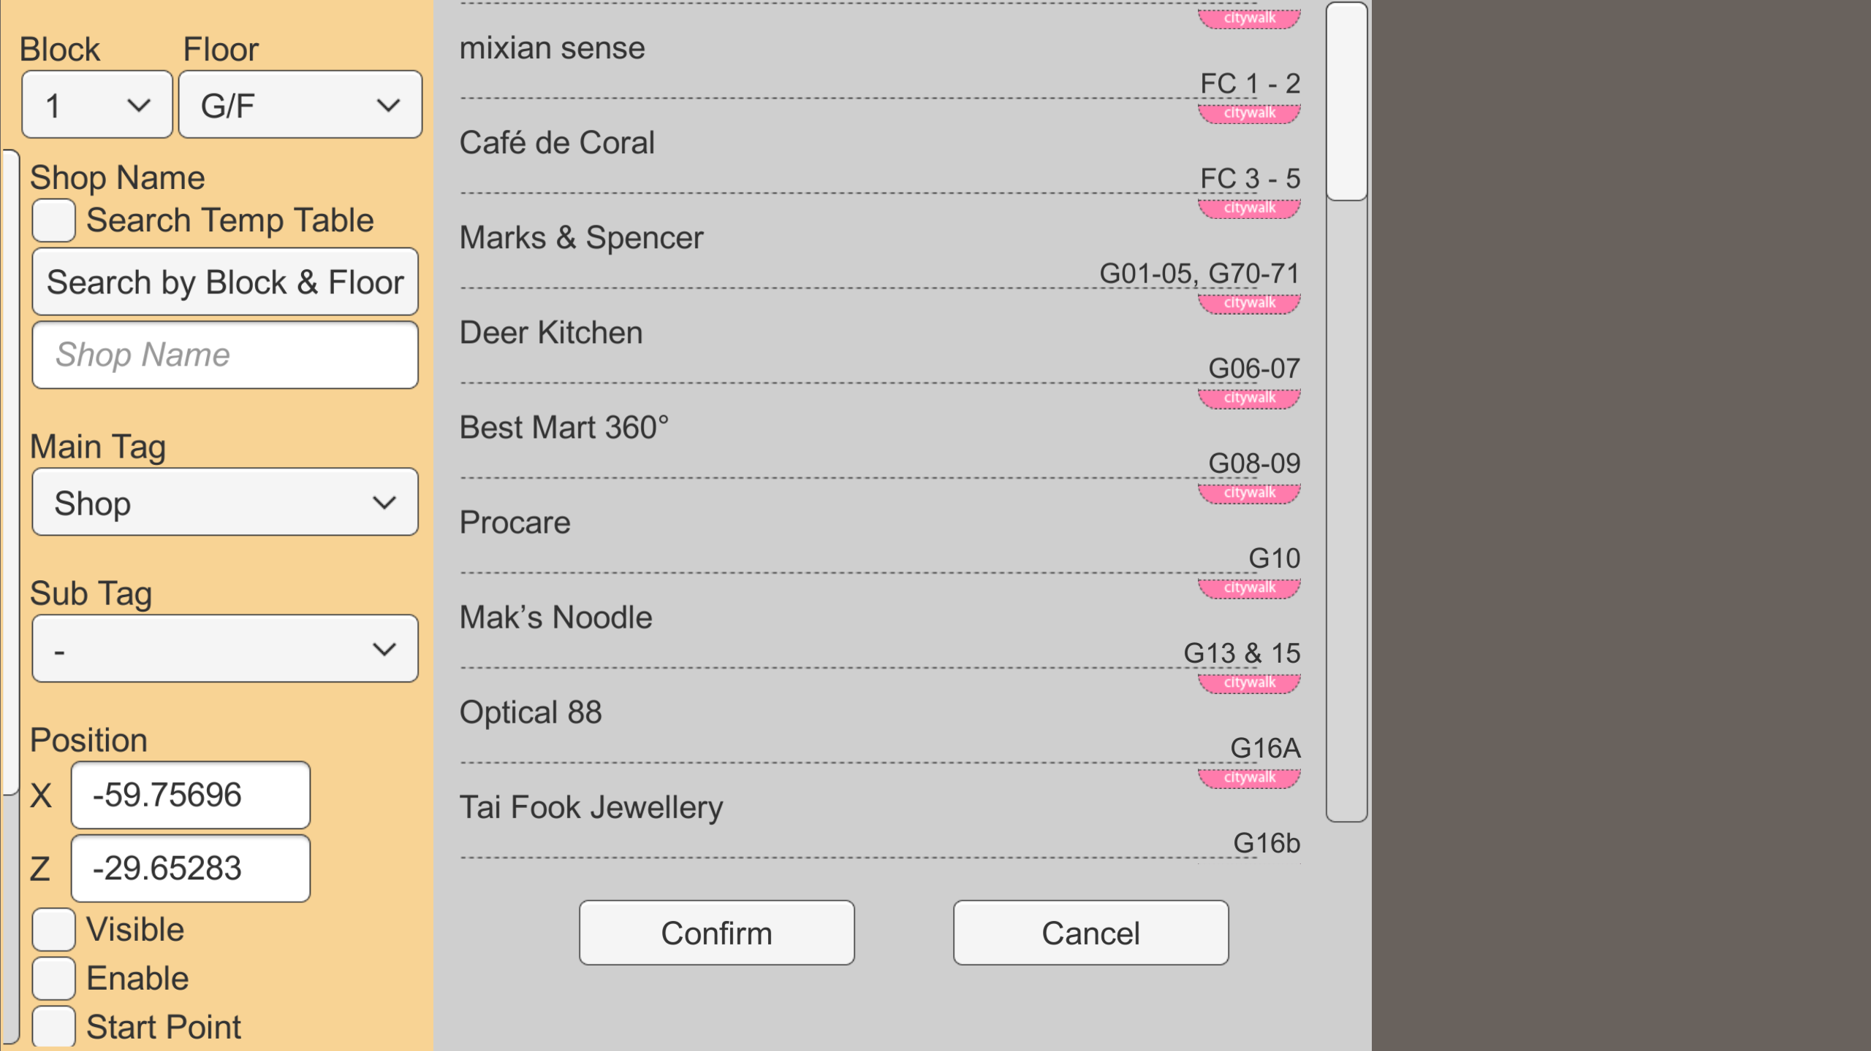
E-Directory Route Editor (PC, Unity)
User can customize the route of points.
The route data is saved on JSON file that can be edit on the editor.
The file also can be edit on other text editor manually.

Slide 5
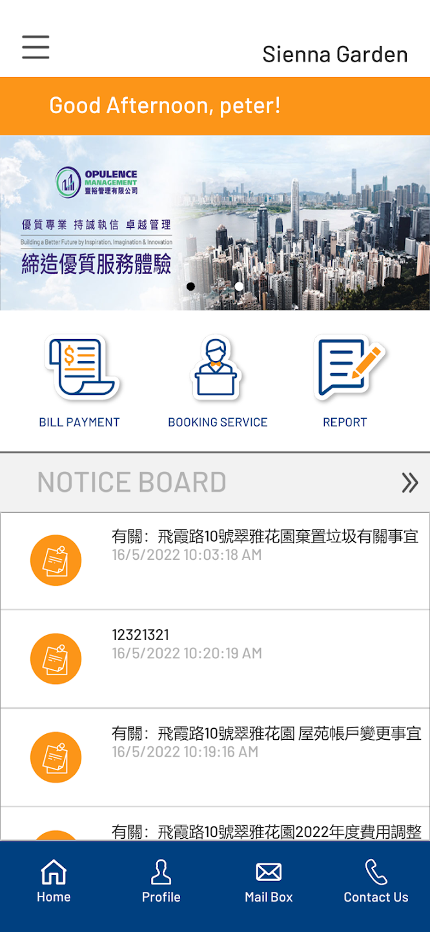
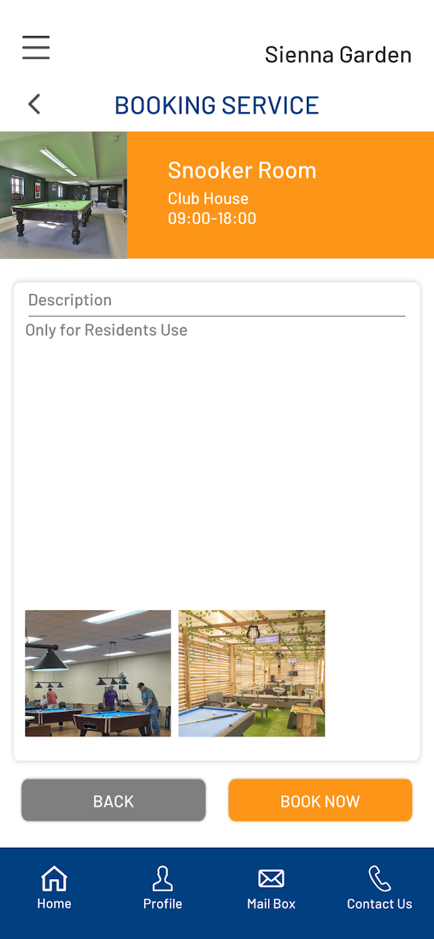
iPMS (Android, IOS, Unity)
Available to homeowners
Post notices (that is web viewer, UniWebView)
Reminders to deliver management fees
Booking service
Data is stored on server, MYSQL, and download via PHP
Used Firebase to send notification messages

Slide 6
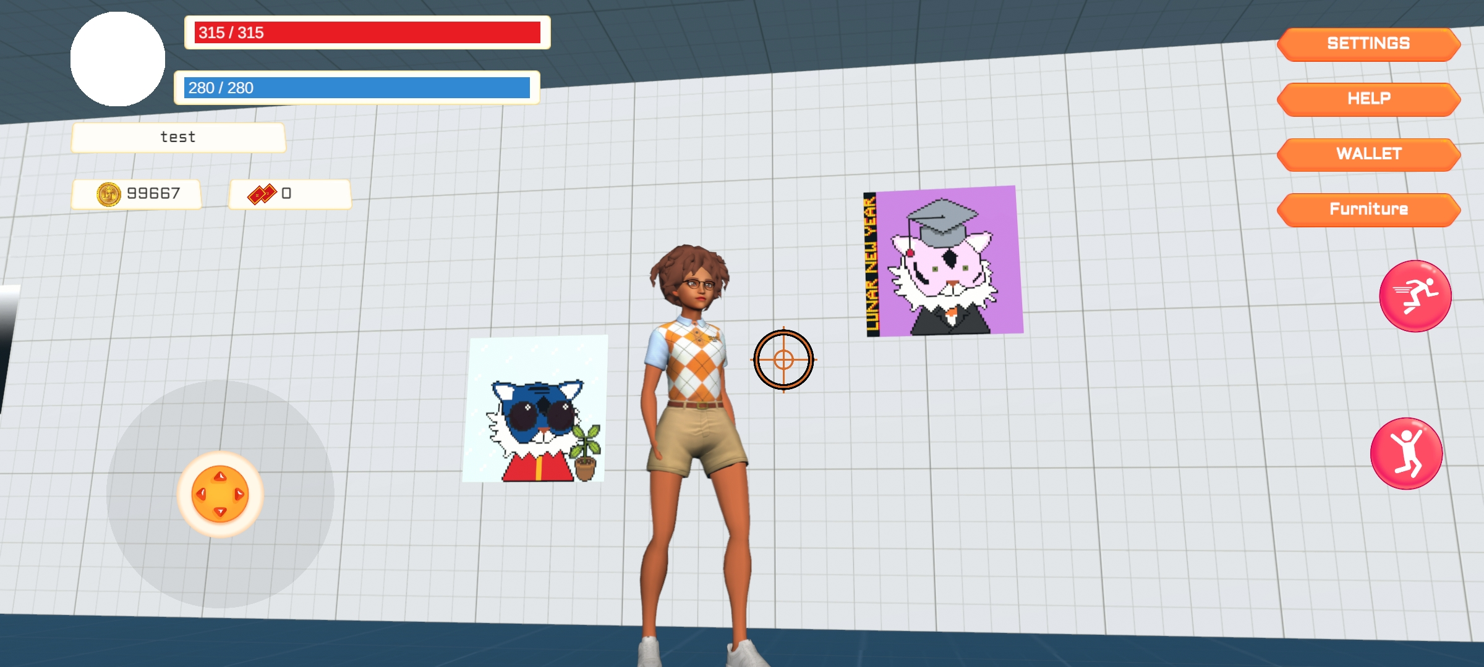
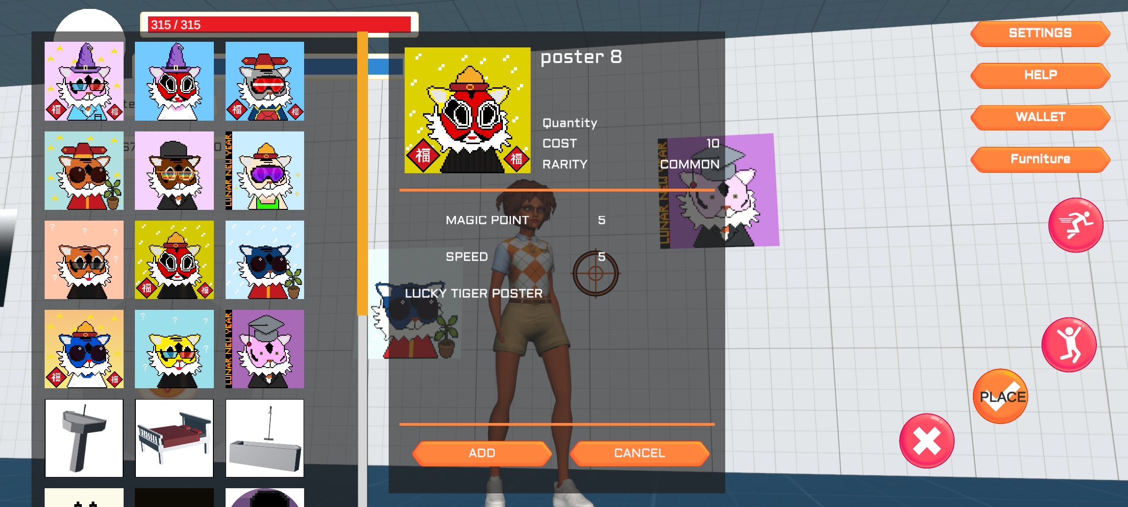
TPS Game (Unity)
It is unfinished prototype. Player can buy furniture to place on their home, e.g. poster image or 3D model.
Used Photon PUN2 to connect between player. Player can visit other player’s house.
Furniture can enhances player’s abilities e.g. Health Point, Attack

